Slide 1
Customer Data Discovery
Contact Center Operations
July 8th, 2020

Slide 2
Agenda – Contact Center Operations
Introduction & Objectives – engagement purpose (as-is & to-be data capability assessment, data roadmap and investment sizing)
Confirm Contact Center Scope & Capabilities – process-centric summarization & platform leverage
End-To-End Data Flows – provide high-level input into upstream, real-time and downstream as-is data domains and pain points
5 mins
10 mins
15 mins

Slide 3
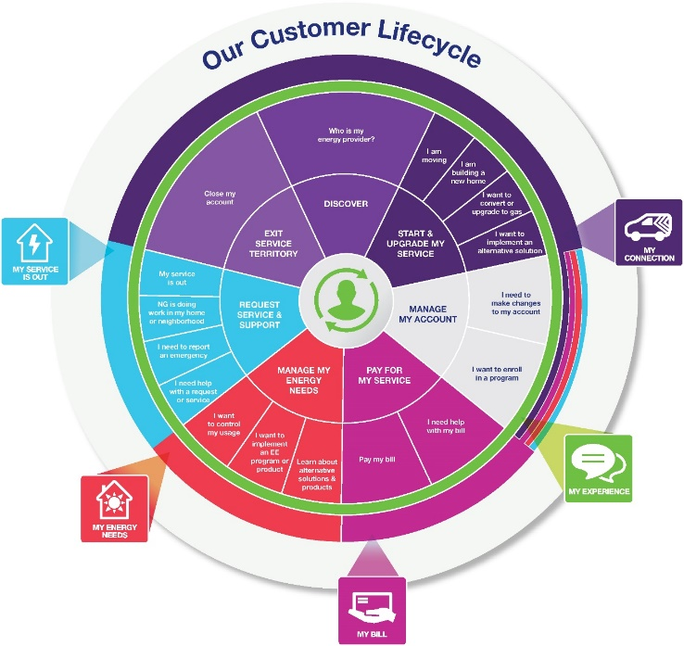
Contact Center Operations – scope & roles
For Discussion
Product/Service Lifecycle
Start My Service (CSS, CRIS, GridForce)
Manage My Account (CSS, CRIS, GBE)
Pay My Bill (CIS, CRIS, GBE)
Manage My Energy Needs (CSS, CRIS, CIAP, GridForce)
Request Service & Support (CSS, CRIS, GBE, Outage, STORMS/Maximo/MWorks, ?)
Prospect (GridForce)
Acquire (GridForce, CSS, CRIS, Web Leads, Vendor Coordination, ?)
Inbound CSR Scope
Outbound or Follow-On CSR Scope
Notes:
Don’t do it just because there is a deadline.

Slide 4


Information Flow Analysis – where does Contact Center Operations play?
Products/
Services
Contact /
Customer
Profile /
Preferences
Lead /
Opportunity
Location
(Premise)
Case
(e.g. Application/
Work Order
Complaint)
Customer
/ Account
Asset
(e.g. Meter /
Product
Thermostat)
Usage
(Meter
Reading)
Bill /
Payment
GL
Account
Data Domain
Market / Sales
Market / Sales
Market / Sales
Service
Service
3
Service
Asset
Asset
Bill/Pay
Finance
Need to align with Electric and Gas Ops Flows
Need to align with Electric and Gas Ops Flows
CSS Transaction Web
1
CRIS Transaction Web
Need to end to end process for Lead/Opportunity for all products
Application Portal (DG/Electric)
Need to add metering systems for input into CIS systems
Marketplaces (EE/EV Products)
2a
Need details Marketplace - Reimbursements for LC&I, Small Business and Trade Partners via DSM. Manual and Automated Flows
Questline / MC (Marketing Comm)
2b
Kubra (Outage Comms)
email
Right Now
CRM Sales (Grid Force)
In-Demand (DSM/EE Program Mgt.)
Applications
CRIS (Gas –NYC,MA)
CSS (Gas, Elec, DG)–UNY,MA,RI,LI)
CRM Service (GBE-RI)
MITS (CSS) / SPIPE / DIS (CRIS)
GIS
Maximo / MDSI
Need to find more details about CRIS GIS Feed
Storms / Mwork / MDSI (LI)
OMS (Outage)
SAP ECC6
CEMP 3rd Party (Uplight / O-Power)
4
CIAP
Customer
Data Platforms
ADA
CDI
CCAE
CSS (Revenue) Data Warehouse
CSQ / Trends
Automated API
Automated Replication
Single data master agreed
No Explicit Master / Implied
Data mastered in multiple applications
(This includes across all Jurisdictions)
DB Link
Manual replication
Notes:
Don’t do it just because there is a deadline.

Slide 5
Master Data Flows
Contact Center Operations Perspectives
Multiple Systems of Record and pathways requiring Contact Center Operations versatility
Ability to see what customer sees (portals and transactional webs)?
Ability to understand interaction history via logs across multiple channels?
Case management across multiple platforms?

Slide 6
Data Flow Challenges – Contact Center Operations?
For Discussion
Working across multiple Systems of Record
Timeliness of account and transactional updates across data sets
Ability to trace interaction and transaction logs
Situational awareness – ability to quickly aggregate and understand likely customer situation
Open transactions/applications
Outages in progress
Work in area
Account status
Account / billing / payment issues
Case management and proactive engagement around service issues

